Slide 1
Science and Politics
Eric Prebys
FRS-003-009

Slide 2
My original title was “Science and Politics don’t Mix”, but that’s silly.
Since most fundamental science is government funded (our government and others), it’s impossible to separate science from politics
Governments can afford to pursue potentially high reward research that’s too risky for private industry.
Politics will always determine priorities.
The problem comes when people try to distort the results of science for political ends.

Slide 3
Science Costs Money (and Often Doesn’t Make Money)
It’s often a very long time between the development of fundamental science and practical application of that science.
Since early times, scientific research has depended on funding that’s not directly related to its objectives:
Science carried out by the aristocracy, using inherited wealth.
Science supported by “patrons”
e.g. Archimedes was supported by the King of Syracuse.
Science supported by side businesses
e.g. Leonardo Da Vinci designed war machinery for the Medicis and others.
Eventually, fundamental research came to be supported by governments.
More about this shortly.

Slide 4
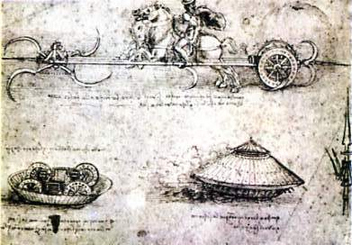
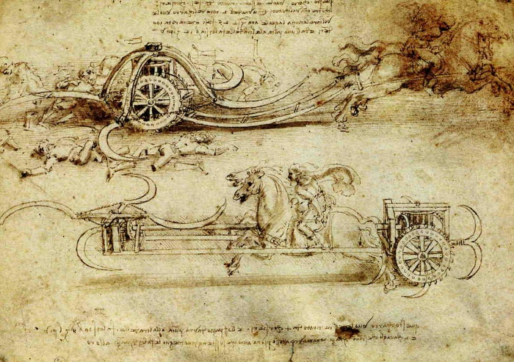
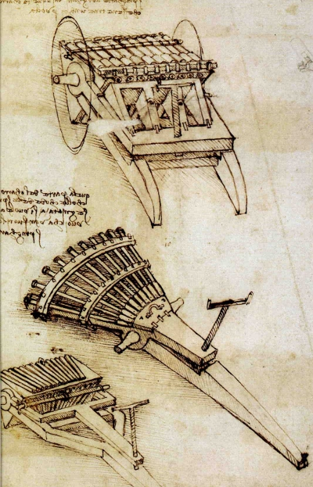
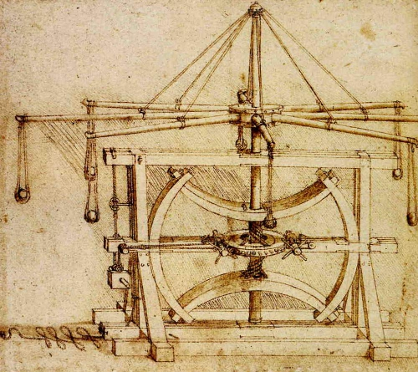
Some of Da Vinci’s Proposed Inventions
Tank
Scythe Chariot
Multi-barrel Guns
Multi-stone catapult

Slide 5
When Bad Things Lead to Good Science
Humans are at their most creative when they’re trying to kill each other.
Word War II drove dramatic scientific and technological advances:
The Allies:
The development of the atomic bomb in the Manhattan Project arguably advanced fundamental physics by 20 years.
The codebreaking efforts at Bletchley Park in the UK advance mathematics and computing
Broke the Nazi Enigma and Japanese Purple codes.
The development of radar at the MIT Radiation Labs revolutionized the understanding and application of E&M
Centimeter radar rendered the German U-Boats ineffective.
Nazi Germany:
Development of the V-2 Rocket, which fed directly into the US and Soviet space programs.
Development Heinkel He 178, the first practical jet.
Their own nuclear program went nowhere, but belief in its existence drove the Manhattan Project in the US.*
*See book, “The Uranium Club” by Miriam Hiebert (forward by Tim Koeth)

Slide 6
Bad Politics: Hampered by Ideology
Reasons the Allies believed the Nazis were further along:
German science had been preeminent since the 19th Century
Many top journals were written in German, including Annalen der Physik, in which Eistein had published his most important papers.
German scientists suddenly stopped publishing papers related to nuclear fission.
The V-2 rocket was incredibly ineffective for delivering conventional explosives, so they assumed it was being designed for a nuclear warhead.
There were lots of reasons they failed, but the biggest were
Kicking out or imprisoning all the Jewish scientists, many of whom had made fundamental contributions to the field.
Many of them ended up working on the Manhattan Project.
Beyond that, nuclear reactors and nuclear weapons depend intimately on “Jewish Physics”.
Quantum mechanics
Special relativity
Werner Heisenberg, the head of the program. had to be extremely careful explaining his work to his Nazi superiors, particularly given his history of defending Jews*.
*I recommend the play “Copenhagen”, by Michael Frayn

Slide 7

Bad Politics Leading to Good Science: The Cold War
The US and the Soviet Union were Allies in defeating the Nazis in WWII
That didn’t last long.
The US developed the first atomic bomb in 1945 and the Soviets followed suit in 1949.
The two countries developed hydrogen bombs in 1952 and 1955, respectively.
The potential for such massive destruction prevented the two countries from going into direct conflict, and the “Cold War” was born.
For the next several decades, this completely dominated world politics.
There were a LOT of downsides to the Cold War
Government interference in Africa and South America by both sides
Proxy wars in Korea and Vietnam
Questionable clandestine intelligence services on both sides: CIA and KGB
But the competition also drove a period of technical and scientific progress unparalleled in human history.

Slide 8
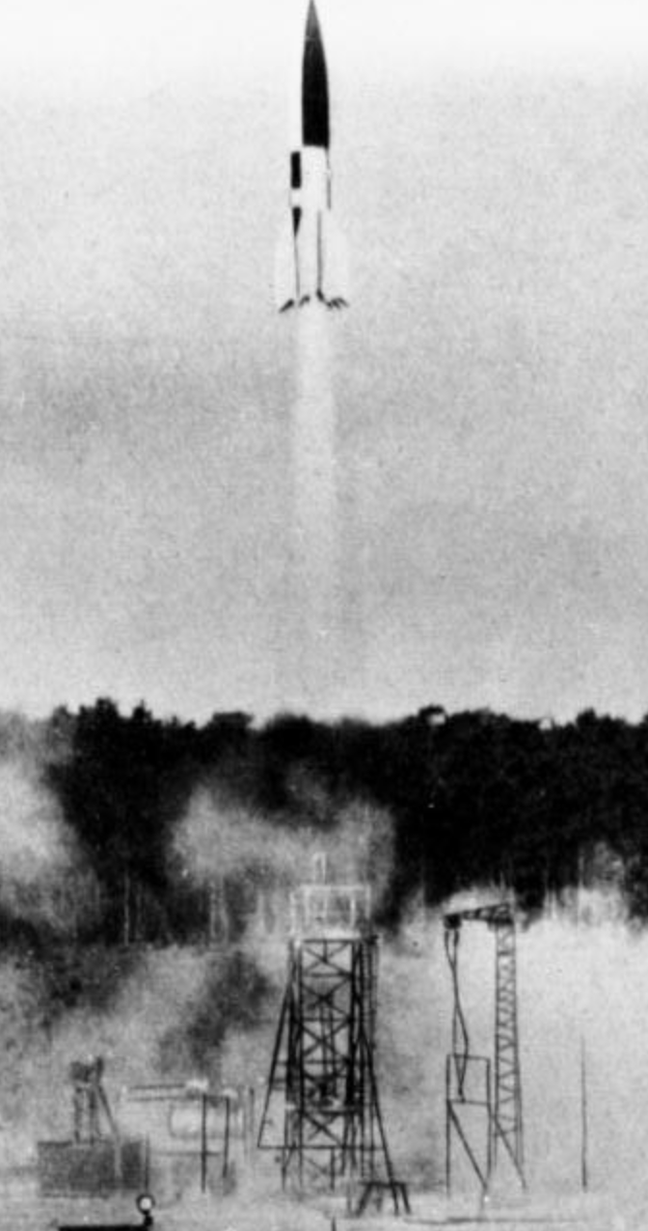
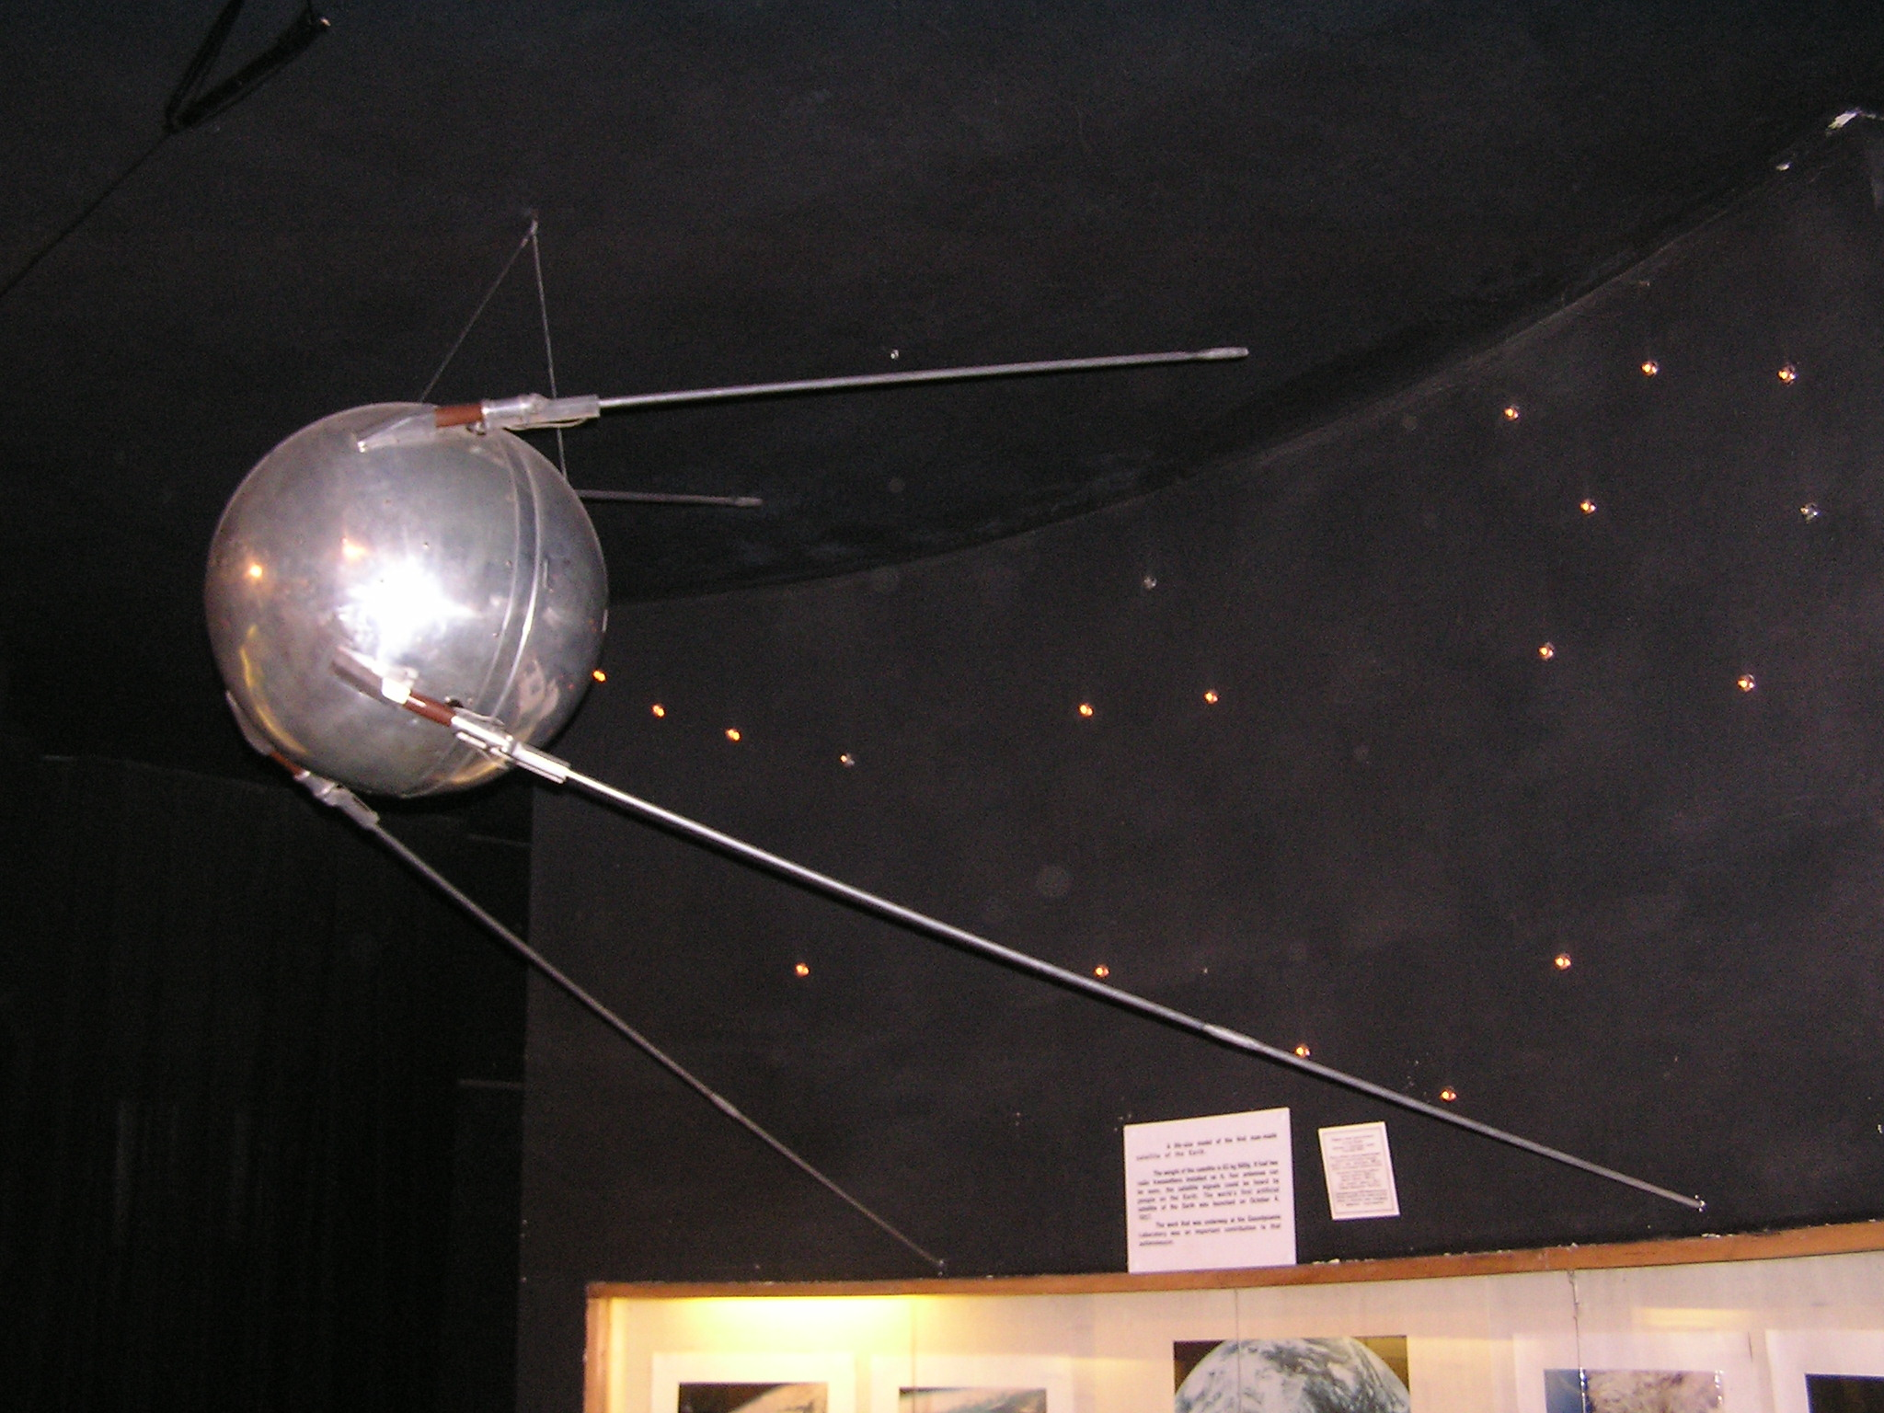
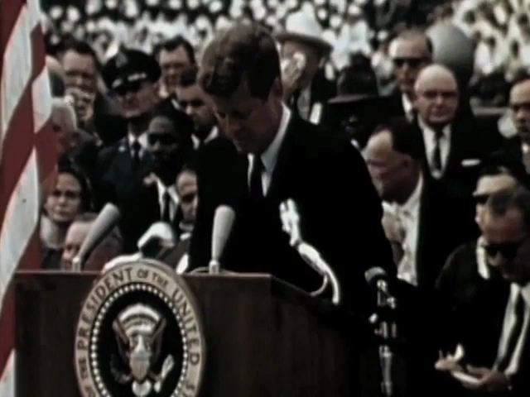
The Space Race
In the 1950s, both the Soviet Union and the US pursued rocket development, based on the knowledge and personnel acquired from the Nazi V-2 program.
The justification was ostensibly scientific, but a big motivation was to develop Intercontinental Ballistic Missiles (ICBMs) capable of delivering nuclear payloads to the other side.
The first big success was when the Soviets launched Sputnik-1, the first artificial satellite, in 1957.
In response, the US dramatically increased funding to and emphasis on both science and education*.
The Soviets stayed WAY ahead for a long time
First animal in space (Laika, 1957)
First lunar probe (Luna 2, 1959)
First man in space (Yuri Gagarin, 1961)
First woman in space (Valentina Tereshkova, 1963)
First space walk (Alexei Leonov, 1965)
But like and addicted gambler, the US kept doubling its bets, with the goal of landing a man on the Moon.
JFK, Rice University, 1962
*Read, “Rocket Boys”, by Homer Hickam, Jr.

Slide 9
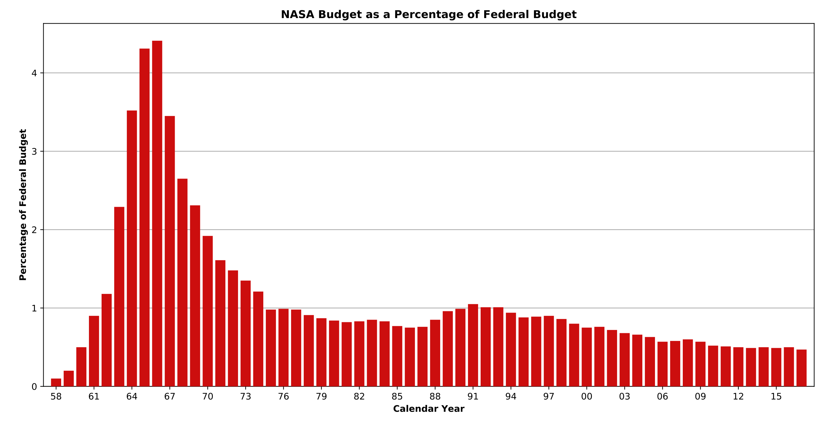
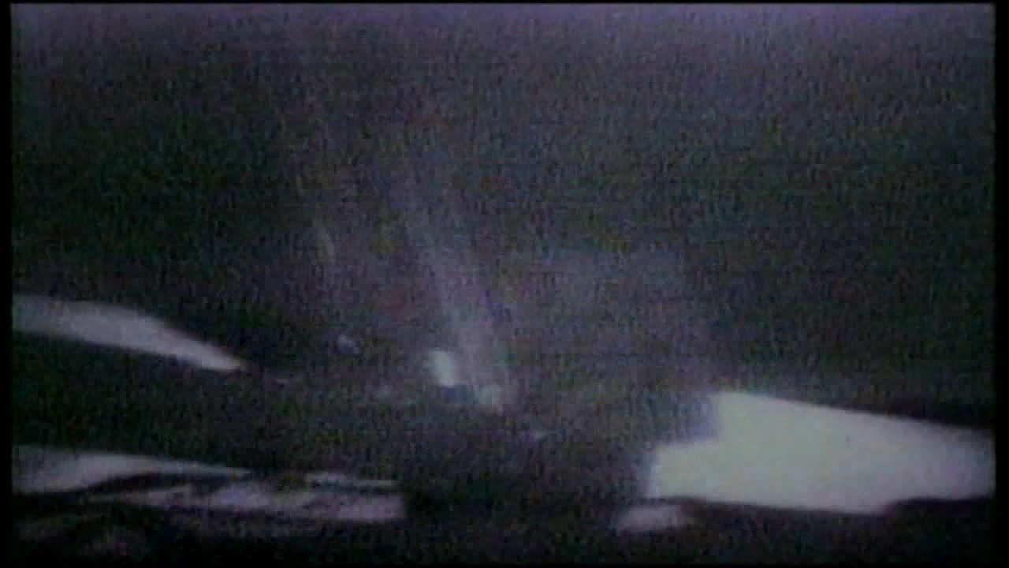
The Moon Race
In the wake of JFK’s assassination, the manned lunar program became his legacy.
The US increased NASA funding to over 4% of the federal budget (10x what it is today)
The program consisted of three projects
Mercury: single man orbital mission
Gemini: two-person capsules, rendezvous in orbit, first US spacewalk. Also tested human endurance in space*.
Apollo: three-person capsules, aimed at landing on the Moon using a separate Lunar Module.
In spite of a disastrous fire that killed the Apollo 1 astronauts on the pad during a test run in 1967, the US was first able to send men around the Moon in 1968 and land on the Moon on July 22nd, 1969.
After several failures of their N1 rocket, the Soviets abandoned their own quest for a manned lunar landing
The Space Race had been won!
*See the book “Packing for Mars”, by Mary Roach

Slide 10
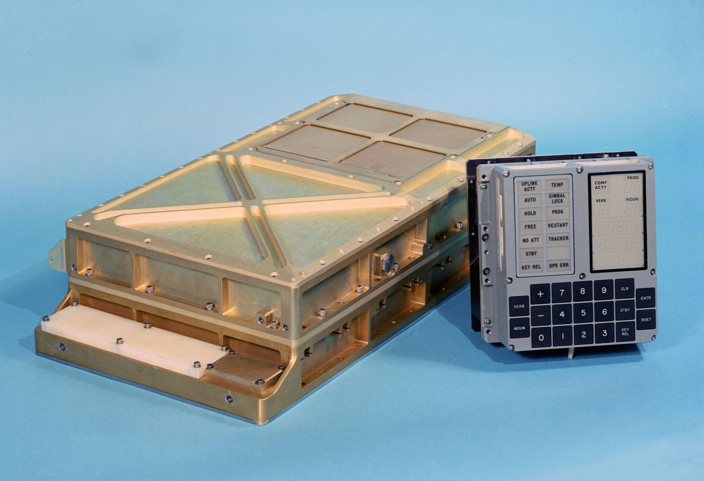
Byproducts of the Moon Race
Computing!
The Apollo Guidance Computer (AGC) represented an amazing leap in computer technology.
Also kickstarted Silicon Valley.
Understanding of the Moon
Origin
Age
Geological activity
Advances in materials science and aerospace engineering.
Understanding space environments
solar wind
Van Allen Belts
Magnetic field variations
Human biology.
Earth and environmental science.

Slide 11

Bad Politics Leading to Bad Science: Lysenkoism
Background: prior to Darwin, the prevailing theory of evolution was “Lamarckian Evolution”, after Jean Baptiste Lamarck.
It held that traits acquired during an organism’s lifetime could be passed down to its descendants.
Example: One generation of giraffes stretches their neck to reach higher branches and the next generation has longer necks

Slide 12
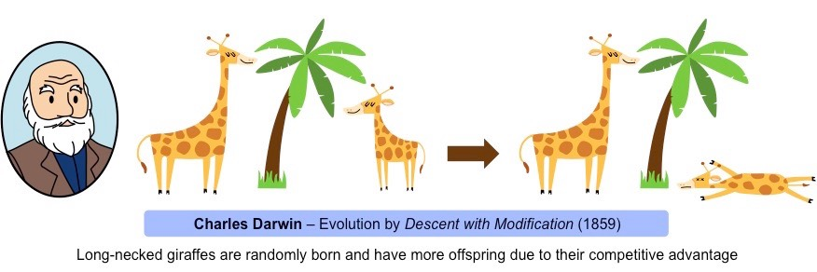
Darwin’s Revelation
Each generation is born with the traits it will pass down.
These do not change during the organism’s lifetime.
Some giraffes are randomly born with longer necks.
Those are more likely to survive and reproduce

Slide 13
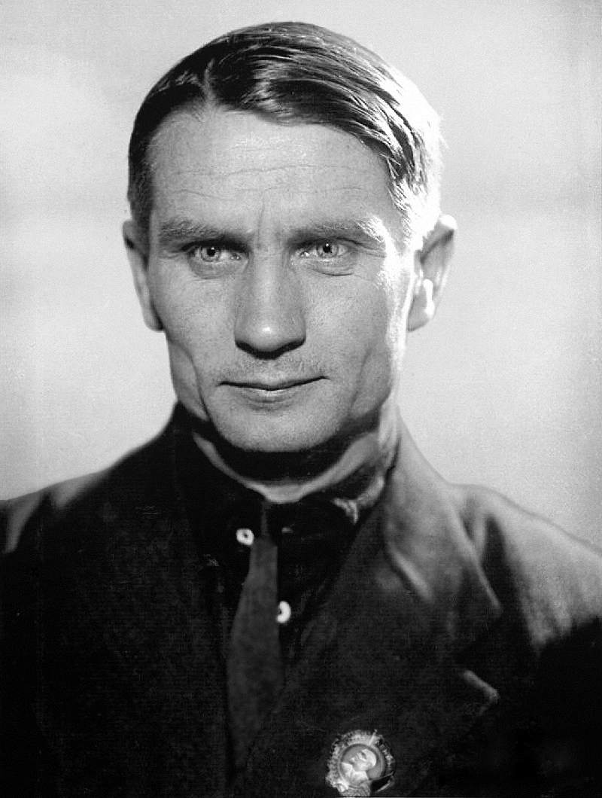
Enter Trofim Lysenko (1898-1976)
Originally, Darwinian Evolution was the official doctrine of the Soviet Union
This was in part of the official atheism of the State.
However, some Marxists didn’t like the idea of random mutations
They felt the concept was at odds with their notion of “universal class struggle” and the “immutable laws of history”.
Trofim Lysenko essentially returned to Lamarckian Evolution with the addition of a more global view.
He rejected the notion of “genes” entirely.
He claimed to have been able to introduce changes to crops which would be passed on to the next generation, with the goal of improving agriculture in the Soviet Union.
He generalized this to the idea that humans could drive their own evolution through collectivization.
Presumably ultimately arriving at the perfect Communist

Slide 14

The Effects of Lysenkoism
By 1948, Stalin had declared Lysenkoism “the only correct theory”.
This was the old school Soviet Union, so “agree to disagree” wasn’t a thing.
Universities were purged of all references to genetics and Darwin.
Biologists and other scientists were required to fully embrace Lysenkoism.
Those that refused – or even hesitated – were terminated, imprisoned, or even executed. Those executed include
The geneticist Izrail Agol.
The physician and geneticist Solomon Levit.
The biologist Georgii Nadson.
Beyond that, Lysenko’s nonsense theories of agriculture contributed to the catastrophe of Soviet farming collectivization.
In the end, 5-7 million people died of starvation.
Lysenkoism began to fall under the weight of its own failures in the 1950s and was finally abandoned in the 1960s.

Slide 15
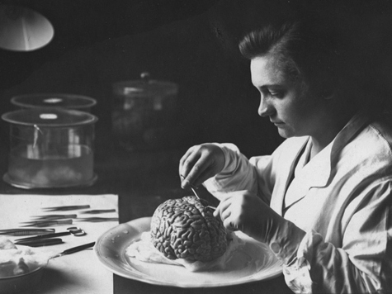
A Funny Footnote: The Moscow Brain Institute
In 1928, the Soviet Union founded The Moscow Brain Institute, initially to study Lenin’s brain.
Their charge was to study brains in order to prove that communist “genius” brains were superior to ordinary brains.
Their collection grew to include Sergei Eisenstein, Maxim Gorky, Joseph Stalin, and many others, including hundreds of brains from ordinary citizens.
This became their “Pantheon of Brains”
They focused on brain weight as a sign of intelligence.
The problem was that Lenin’s brain weight was below average.
They explained this by blaming it on his multiple strokes.
In his case, they instead focused on the pyramidal cells in the third layer of the central cortex, which appeared to be unusually well developed.
They spent decades slicing and dicing brains and writing nonsense papers.
The original institute was disbanded in 1989 after the fall of the Soviet Union, having learned nothing of any particular value.

Slide 16
The Importance of Government Funding
In 2007, Norman Augustine, former Chairman and CEO of Lockheed Martin, convinced the National Academies of Science to appoint him to lead a commission into federal funding of fundamental science.
The result was “Rising Above the Gathering Storm: Energizing and Employing America for a Brighter Economic Future”
From the introduction
The prosperity the United States enjoys today is due in no small part to investments the nation has made in research and development at universities, corporations, and national laboratories over the last 50 years. Recently, however, corporate, government, and national scientific and technical leaders have expressed concern that pressures on the science and technology enterprise could seriously erode this past success and jeopardize future US prosperity.
The report made numerous recommendations, but I’ll highlight this one:
Action B-1: Increase the federal investment in long-term basic research by 10% each year over the next 7 years through reallocation of existing funds or, if necessary, through the investment of new funds. Special attention should go to the physical sciences, engineering, mathematics, and information sciences and to Department of Defense (DOD) basic-research funding. This special attention does not mean that there should be a disinvestment in such important fields as the life sciences or the social sciences. A balanced research portfolio in all fields of science and engineering research is critical to US prosperity. Increasingly, the most significant new scientific and engineering advances are formed to cut across several disciplines.

Slide 17
Why is Government Funding Important?
To put it simply, government can afford to fail.
According Mr. Augustine, the R&D horizon for investment return in industry is typically two years.
That is, if a business invests in R&D, they want a high probability of a viable product in no more than two years.
In contrast:
In many fields, like quantum computing, we are only now beginning to exploit physics that was studied over 100 years ago.
Many, MANY, potential technologies fail on the road to finding one that’s viable.

Slide 18
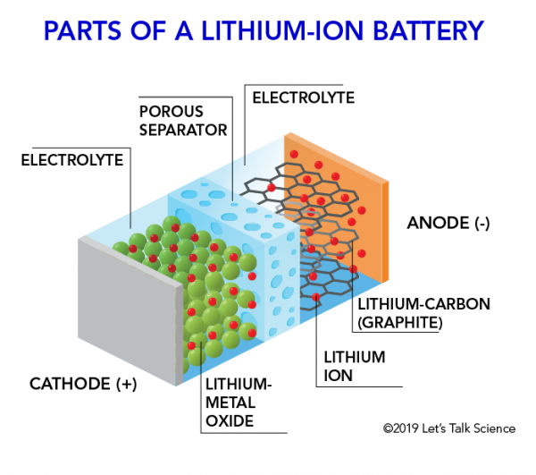
Case in Point: Lithium-ion Batteries
The quest for durable high-density rechargeable batteries had been a major priority for a very long time.
The priority has only increase with the push for electric cars and the desire to store energy from intermittent sources like wind and solar.
Lithium-ion batteries represented a major improvement over previous lead-acid batteries and NiCad batteries.
Key milestones in the development were a combination of industrial and government funded research:
M. Stanley Whittingham developed the basic process at Exxon in 1970, based on a body of existing academic work
John B. Goodenough developed the LCO cathode in 1980, while at Oxford University.
Rachid Yazami developed the Carbon/Graphite Anode in the mid-1980s while at the French National Centre for Scientific Research.
All of this allowed Sony to first commercialize the first Li-ion battery in 1991.

Slide 19
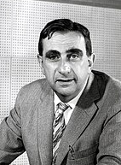
Science and Secrecy Don’t Mix
Peer review is the core of scientific research.
Operating in the isolation of classified research, even good researchers can make mistakes that go unchecked.
Not everyone involved are good researchers.
You should have read Bob Park’s account of Edward Teller and the non-existent X-ray laser.
This was just one example of questionable research that was funded under the auspices of the Strategic Defense Initiative (SDI)
There are plenty of other examples of secret science gone bad.

Slide 20
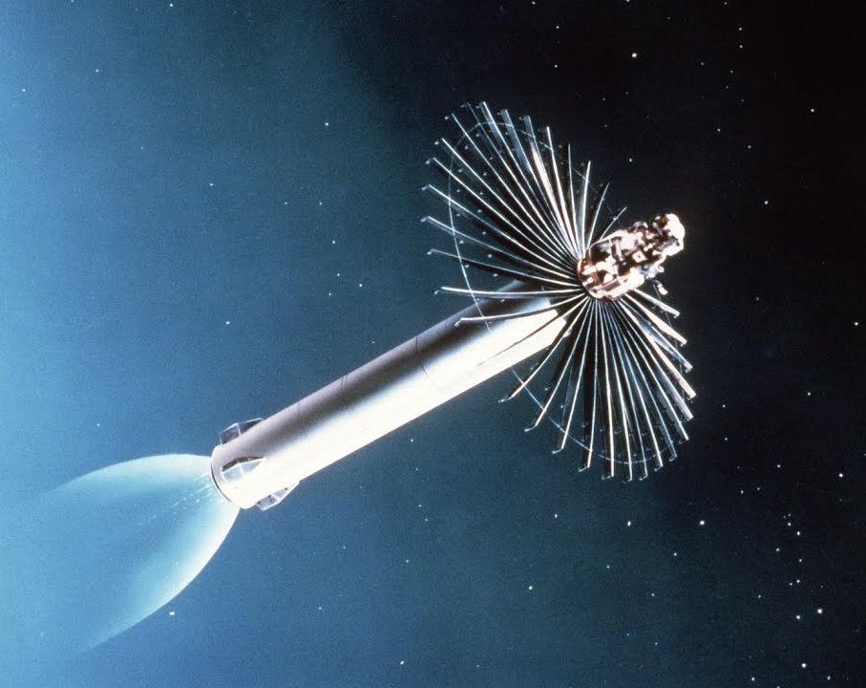
More SDI Shenanigans
In addition to space lasers, a huge part of the SDI program was the missile defense system.
In 1984, a major success was announced
The Homing Overlay Experiment (HOE) claimed to have successfully intercepted an incoming missile using autonomous tracking.
In fact, the target had been fitted with infrared beacons to make the tracking easier.
Something incoming Soviet missiles would be unlikely to have.
When confronted by a whistleblower, the DoD admitted to “miscommunication”, while stopping short of admitting they had simply cheated.
The US now claims to have a fully reliable missile defense system, but do we believe it
See movie, “A House of Dynamite”

Slide 21

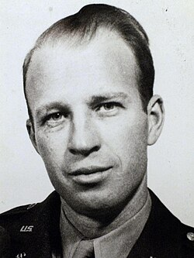
An Even Dumber Example: MKUltra
We’ve talked about CIA research in the paranormal at SRI.
Their other secret program in the area was MKUltra, begun in 1953
Their goal was to investigate "chemical, biological, and radiological" methods of mind control.
To this end, they experimented on American citizens, in total violation of the law.
They primarily focused on LSD.
On the upside, their experiments in Palo Alto inspired Ken Kesey (“One Flew Over the Cuckoo’s Nest”)* and indirectly gave us the Grateful Dead.
On the downside, their program resulted in several deaths.
In particular, Frank Olson was given LSD without his knowledge and jumped out of a window during a psychotic episode.
In one colorful “experiment” known as Operation Midnight Climax, clients of prostitutes were given LSD.
An agent observed them through a two-way mirror from a hidden room equipped with a toilet and a refrigerators.
In the end, nothing that could be called “science” ever came out of the program, and it was terminated in 1973.
*Read “The Electric Kool-Aid Acid Test”, by Tom Wolfe

Slide 22
JASON
In response to concerns about stovepiping in classified research, the JASON advisory group was formed in 1958*.
The goal was to allow them broad access to classified research to evaluate its potential and identify potential flaws.
They were given the latitude to be completely self-directed.
Membership has included some of the greatest scientists of the 20th Century
John Wheeler
Hans Bethe
Steven Weinberg
Freeman Dyson
etc.
Notable achievements include a report by Steven Weinberg, Freeman Dyson, et al, which established the impracticality of introducing nuclear weapons into the Vietnam War.
They also exposed flaws in a number of classified research projects.
Unfortunately, their role was sidelined in 2002 when they decided to look into climate change.
*read “The Jasons: The Secret History of Science's Postwar Elite”, by Ann Finkbeiner

Slide 23


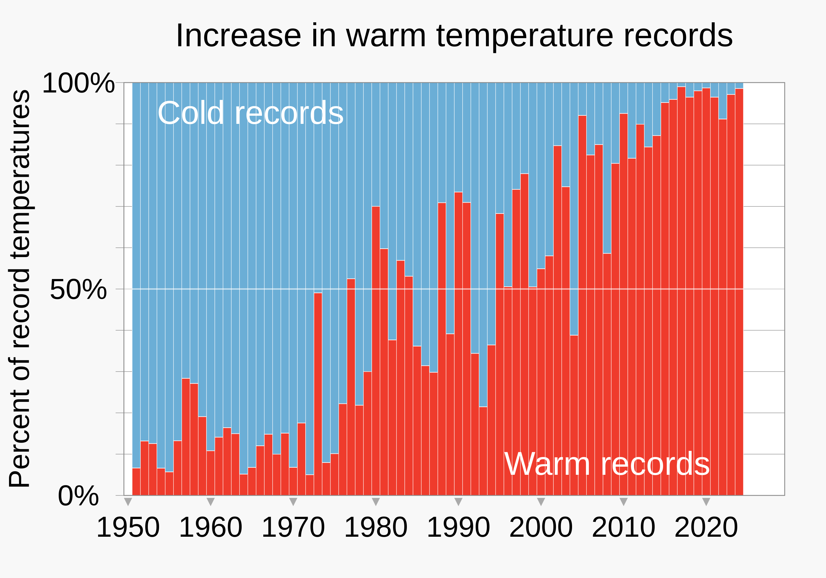
Climate Change: The Political Elephant in the Room
As we have discussed many times, a warning sign of voodoo science is something that always remains at the limit of detection.
Anthropomorphic climate change is NOT like that.
When “An Inconvenient Truth” was released in 2006, there was still room to be skeptical.
In the two decades since, the evidence has become overwhelming.
The Committee for Skeptical Inquiry called on the media stop using the term “climate skepticism” in favor of the term “climate denial”.

Slide 24
So What’s the Problem?
There are basically no credible scientists who continue to question the basic tenets of climate science
The Global Climate Coalition, formed in 1989 to challenge the science of climate change was disbanded in 2001.
One of the last holdouts was Richard Linzen at MIT, and he’s been very quiet in the last few years.
In the same way that the Tobacco Industry fought to suppress the science tobacco and lung cancer, the fossil fuel industry has to great lengths to suppress the science of climate change.
For example, Dr. Willie Soon, an Astrophysicist at the Harvard–Smithsonian Center for Astrophysics became an outspoken “skeptic” regarding climate change.
In 2015, it was discovered that he had failed to disclose $1.25M (!) in funding from the fossil fuel industry.
For the record, the fossil fuel industry doesn’t typically fund astrophysics.
And of course, money buys politicians, too.
The fossil fuel industry spends of $100M/year on political lobbying and over $400M on political campaigns
This might have something to do with certain politicians calling climate change a ”hoax” - in spite of ALL evidence to the contrary.

Slide 25

The Media is a Big Part of the Problem
As we’ve discussed before, there aren’t two sides to every story.
If climate science is so important, why do we never hear from climate scientists?
Neil DeGrasse Tyson is a great scientist and communicator, but he’s not a climate scientist.
Bill Nye the Science Guy is a great educator, but he’s a mechanical engineer.
Greta Thunberg is a very effective activist, but not a scientist.
Leonardo DiCaprio is a great actor.
For example, Prof. David Archer is an outstanding climate scientist at U of Chicago
Long publication record.
He’s written several popular books on climate change
Runs the RealClimate blog.
Why haven’t I seen him on the news?

Slide 26

Getting Involved in the Process
In many ways, physics got a blank check as a result of its contributions in WWII
Priorities were set within the community
These were community and communicated to the government at the highest levels.
They usually got what they wanted.
People at lower levels were never encouraged to get involved
This stopped with the end of the Cold War
Example: The Superconducting Super Collider (SSC) was a largeparticle collider to be built in Texas.
It was started during the Reagan Administration in response to a smaller collider being planned in the Soviet Union
It was terminated in 1993 as part of the “peace dividend”.
We tried to save it with a big lobbying trip to Washington, but it was too little too late.
Now, scientists at all levels are expected and encouraged to get involved with the process of influencing government.
After the failure of the SSC, this saved US funding for the Large Hadron Collider in Europe.
I highly recommend the experience to everyone.

Slide 27
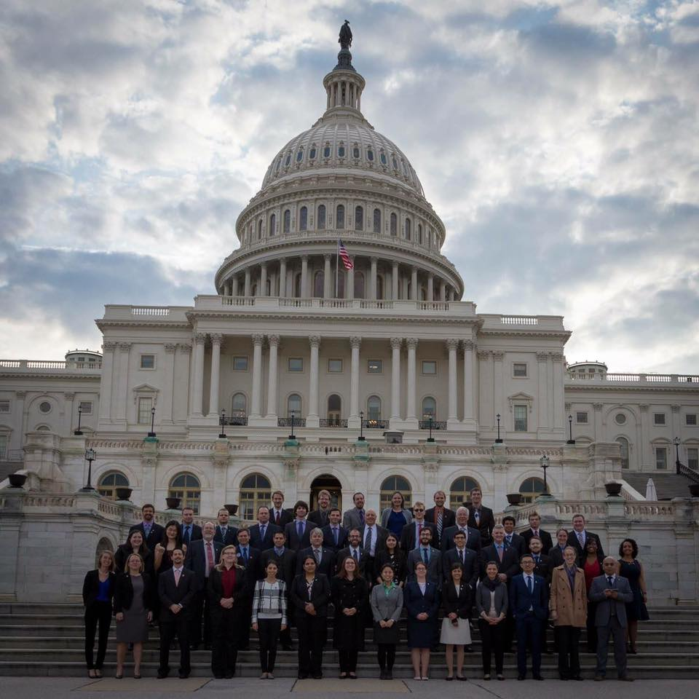
March, 2017 URA Washington Visit
Sponsored by the Universities Research Association (URA) to lobby for High Energy Physics research:
Primarily LHC funding and large scale neutrino experiments in the US.
Organized by the Fermilab Users Executive Committee
We teamed up in pairs and visited over 330 Congressional and Senate offices.
Me in a suit

Slide 28
Final Thoughts
Government funding is essential to fundamental research.
Politics will always influence the research priorities.
Start to worry when politics tries to influence the results of research.
Be very suspicious of research done in secret.
You can be part of the process!

